Slide 1
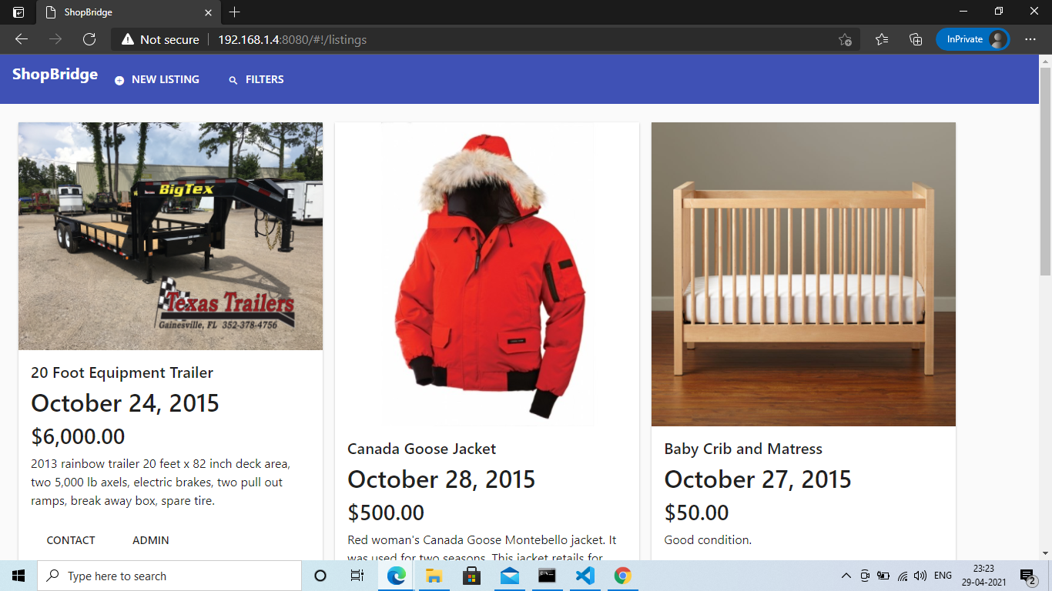
Landing Page (accessed by starting http-server and giving route as ‘/listings’ )
Button to add new Listings
Displays listings with attributes, title, date of creation, price and description
User controls such as show contact, and admin controls to edit/ delete a listing

Slide 2
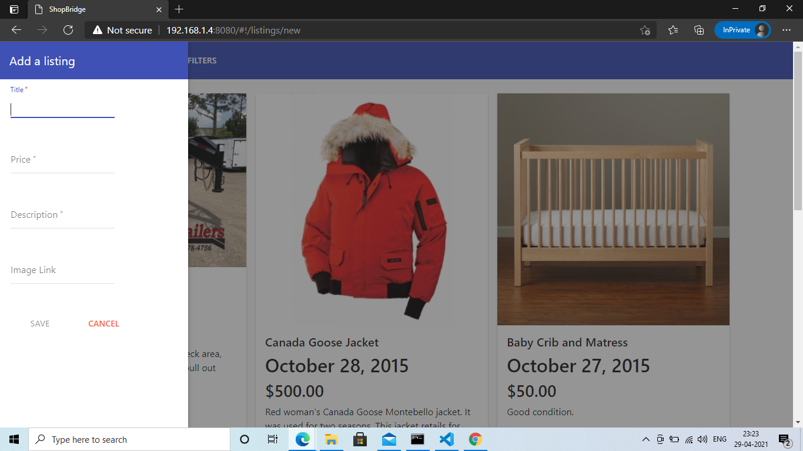
Page to add a new listing (and route changed to ‘/listings/new’ )
When a new listing button is clicked, a sidebar form opens to submit values for a new listing

Slide 3

Client-side validations for the input fields if they are touched and are invalid
Save button is disabled until all the input fields are entered

Slide 4
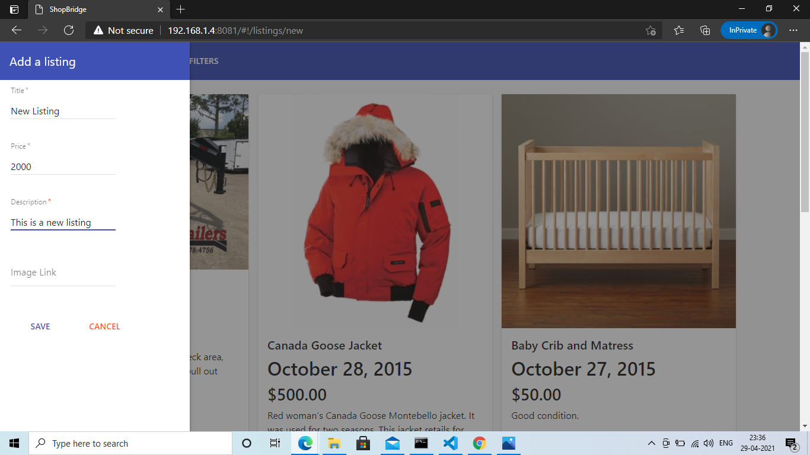
Save button is enabled after filling in the required fields

Slide 5
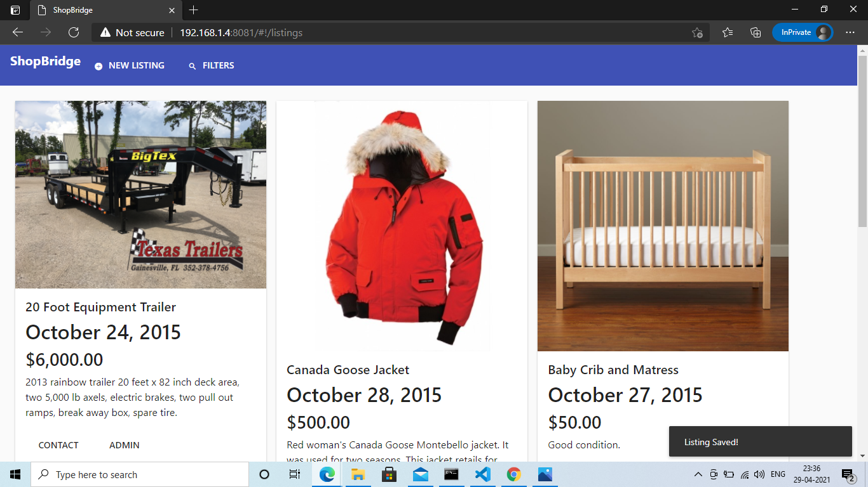
An alert to show that the listing is saved.

Slide 6
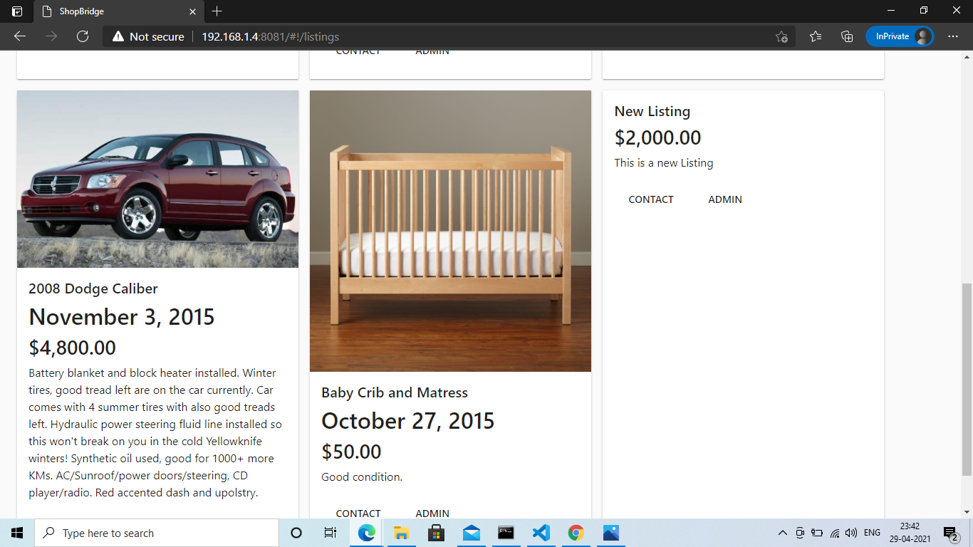
New listing can be found in the list when the user paginates to last page
Image is not present because no link given in the image input field, refer slide 4

Slide 7
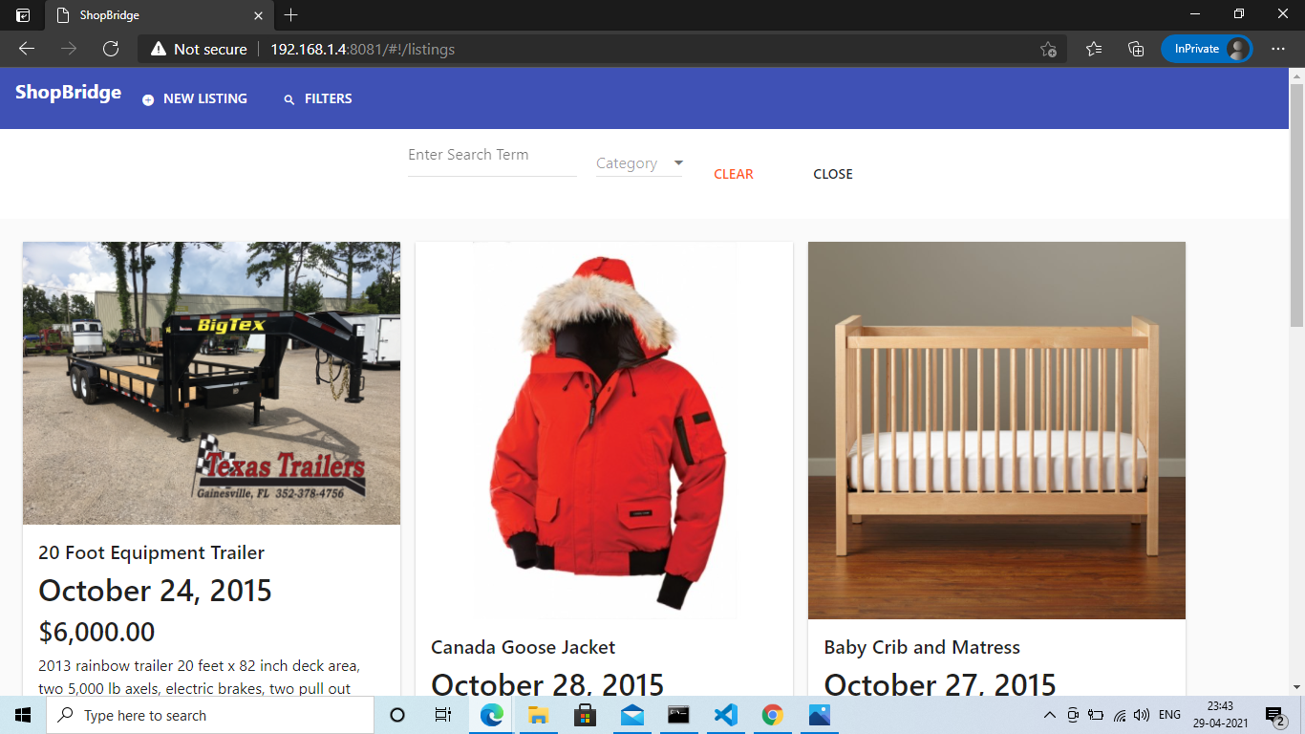
Filter option in Navbar to filter the listings, can be achieved through searching or category dropdown.
Clear button to clear the filters.
Close button to hide the filter menu.

Slide 8
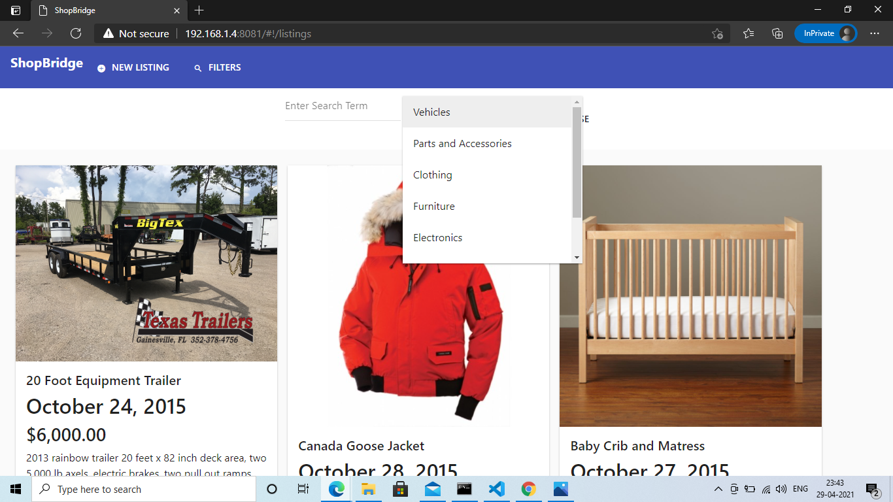
Dropdown filter to filter listings based on category.

Slide 9
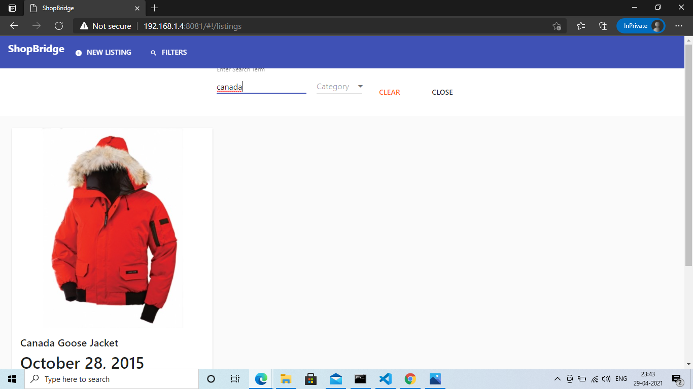
Search filter to filter listings based on string typed in the search input.

Slide 10
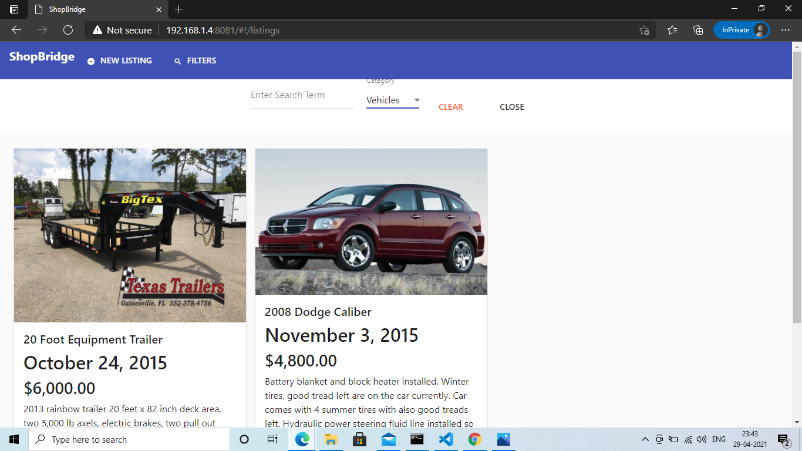
Dropdown filter in action.

Slide 11
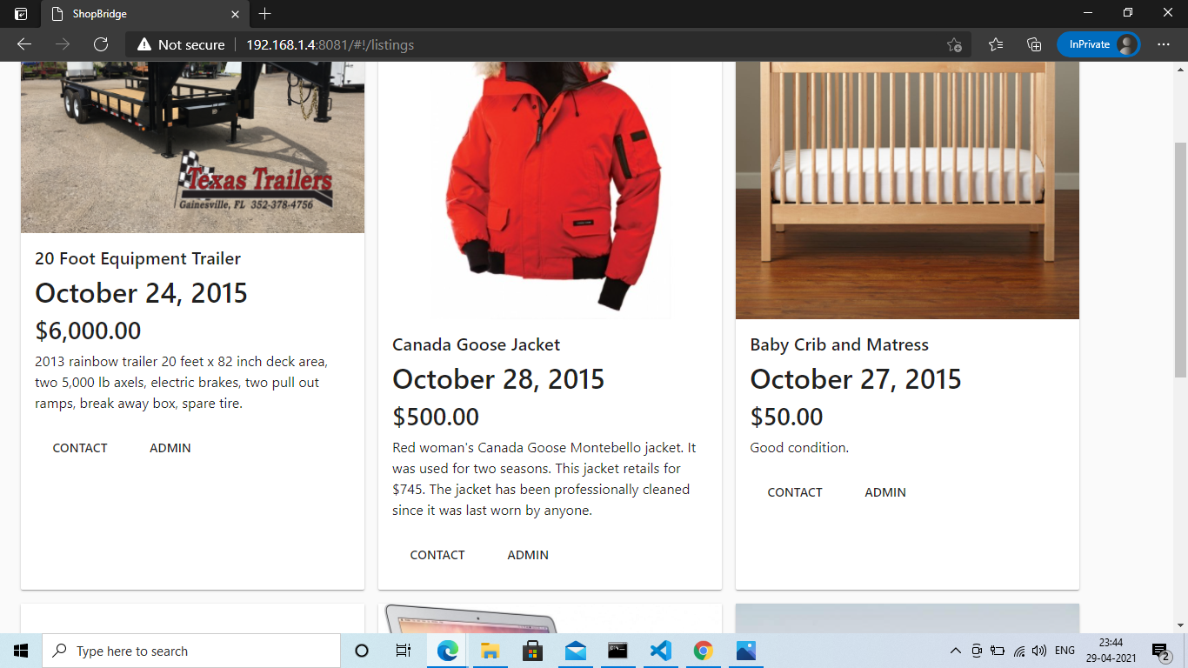
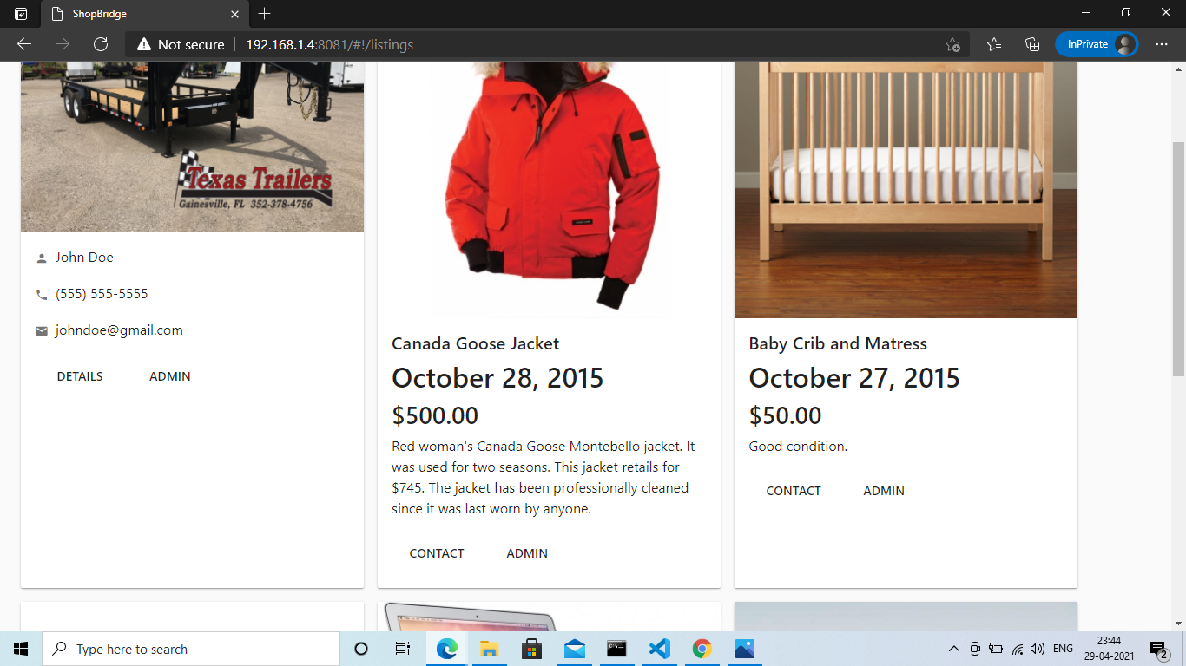
User controls/Admin controls and some showing and hiding of data based on user input.

Slide 12

Admin Controls.

Slide 13

Page to edit a listing (and route changed to ‘/listings/edit/:id’, id represents the params which will be passed when user clicks on Edit button of a particular listing under Admin controls)
All input fields are already filled when the user clicks edit.

Slide 14

Route params i.e. ‘id’ changes in the url when particular listing is edited.

Slide 15
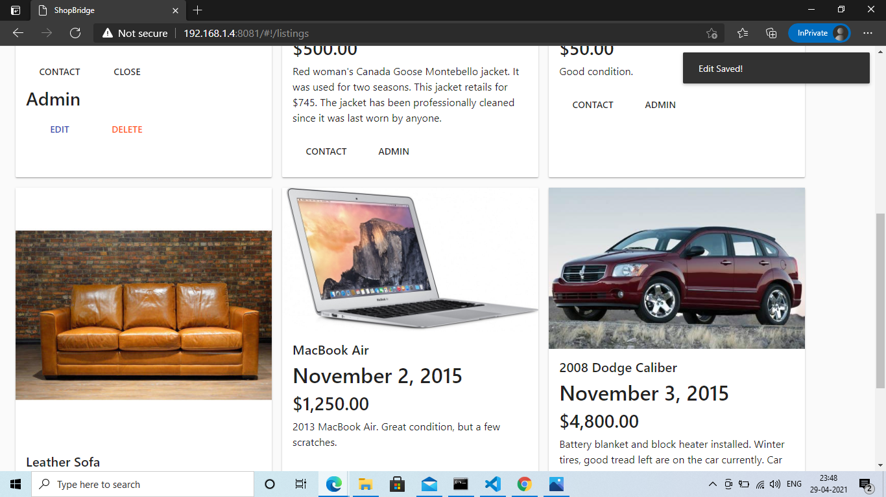
An alert to show that the listing is edited.

Slide 16
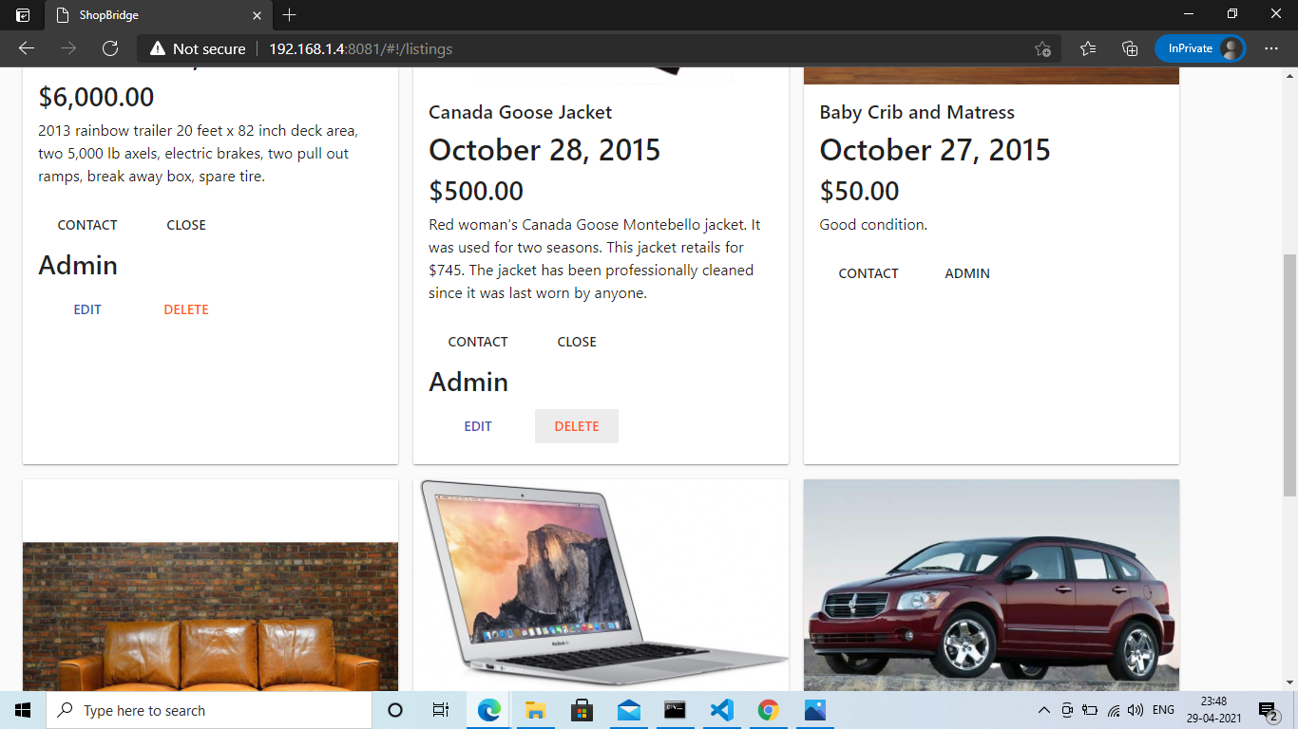
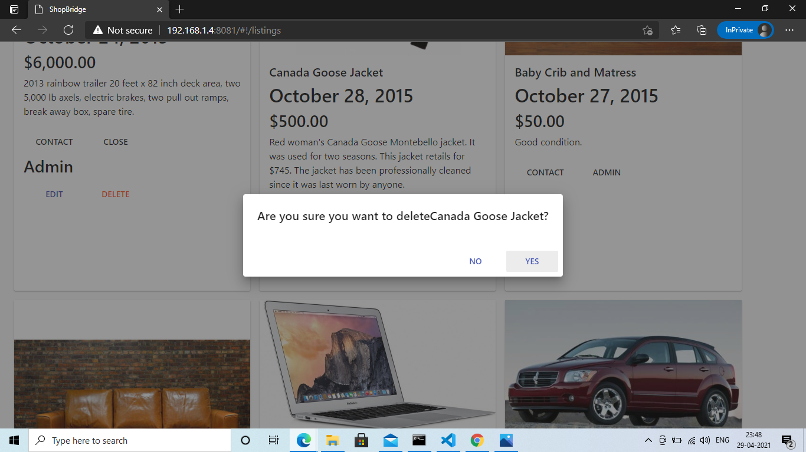
Deleting a listing, a confirm Dialog with Yes(confirm) & No(cancel) button.

